Slide 1

Introduction to Git
Jason Yau
Ref: https://courses.cs.washington.edu/courses/cse403/13au/lectures/git.ppt.pdf

Slide 2

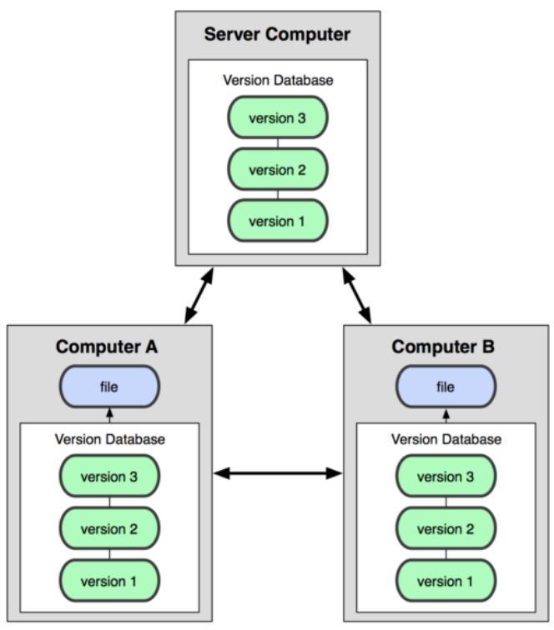
Centralized VCS
e.g. Subversion (SVN) & Perforce
Distributed VCS
e.g. Git & Mercurial

Slide 3

About Git
Created by Linus Torvalds, creator of Linux, in 2005
Came out of Linux development community
Designed to do version control on Linux kernel
Goals of Git
Speed
Support for non-linear development (1000+ of parallel branches)
Fully distributed
Able to handle large projects efficiently

Slide 4
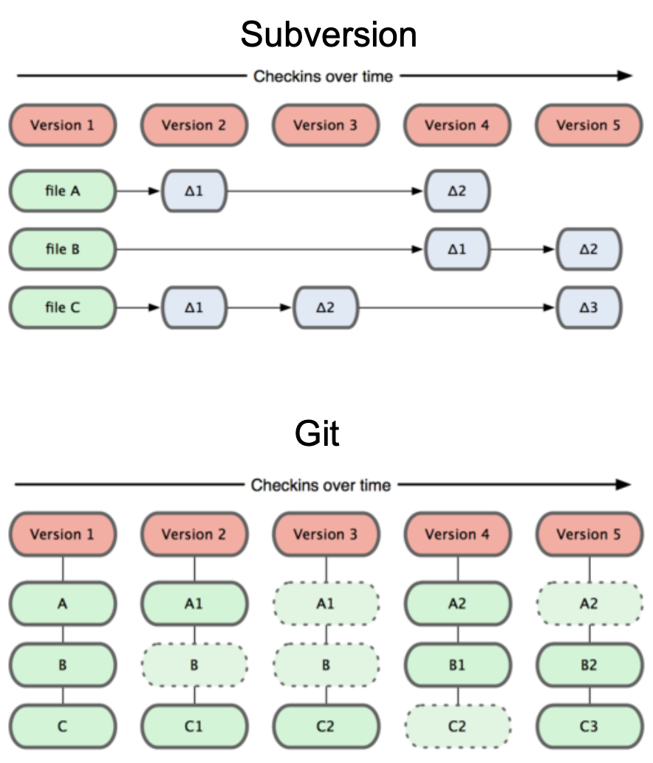
Git snapshots
Centralized VCS track version data on each individual file
Git keeps "snapshots" of the entire state of the project
Each checkin version of the overall code has a copy of each file in it
Some files change on a given checkin, some do not
More redundancy, but faster

Slide 5
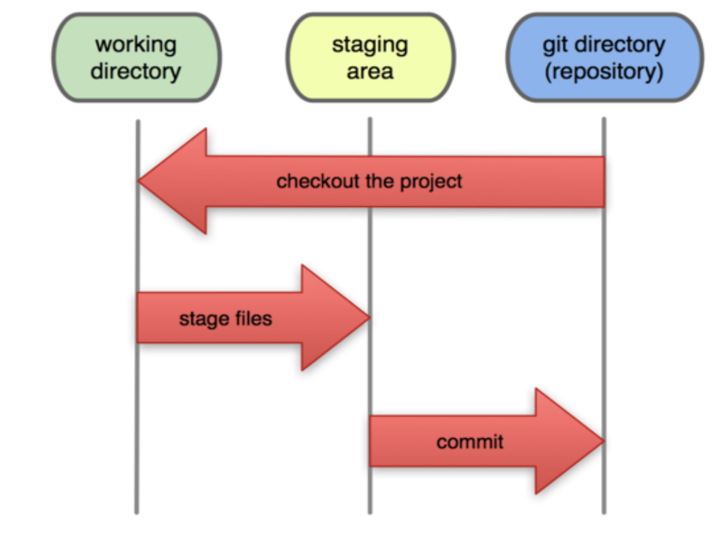
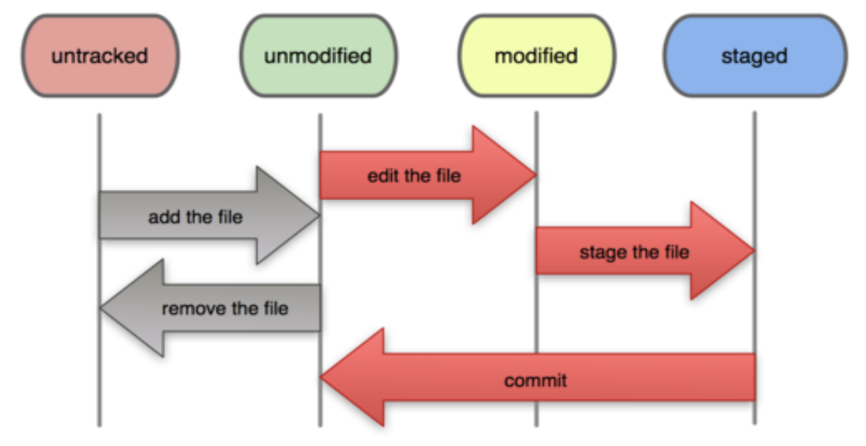
Local Operations
File Status Lifecycle
Local Git
Modified /
Unmodified
Files
Staged
Files
Committed
Files

Slide 6
Git commands
Important command - git help

Slide 7
Creating a Git Repository
Local Git Repo
git init
>README.md # Create a file
git status # Check file status
git add . # Add all file changes into staging area
git status # Check file status again
git commit -m ‘Init Git’ # Commit with message
git log # Check commit history
Remote Git Repo
git clone [url] [localDirectory]
Ignore Unwanted Files
.gitignore
Notes:
git log --graph --abbrev-commit --decorate --format=format:'%C(bold blue)%h%C(reset) - %C(bold cyan)%aD%C(reset) %C(bold green)(%ar)%C(reset)%C(bold yellow)%d%C(reset)%n'' %C(white)%s%C(reset) %C(dim white)- %an%C(reset)' --all

Slide 8
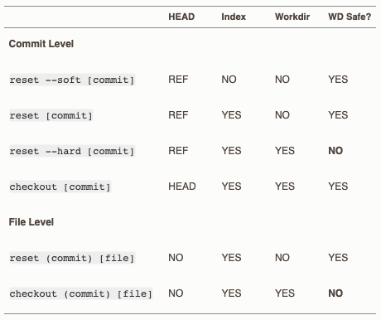
Resetting Local Commit
git reset
Reset current HEAD to the specified state
mixed [default]
Keep changes in working area
soft
Keep changes in staging area
hard
Remove all changes
git checkout
Switch branches or
restore working tree files
Only reset file but would not remove commit

Slide 9
Temporary Store Working Changes
git stash
# Store for both working and staging area
--keep-index # Store for working area only
git stash apply [stash]
Apply latest / specific stash into current working area
git stash pop [stash]
Apply latest / specific stash into current working area then remove it

Slide 10
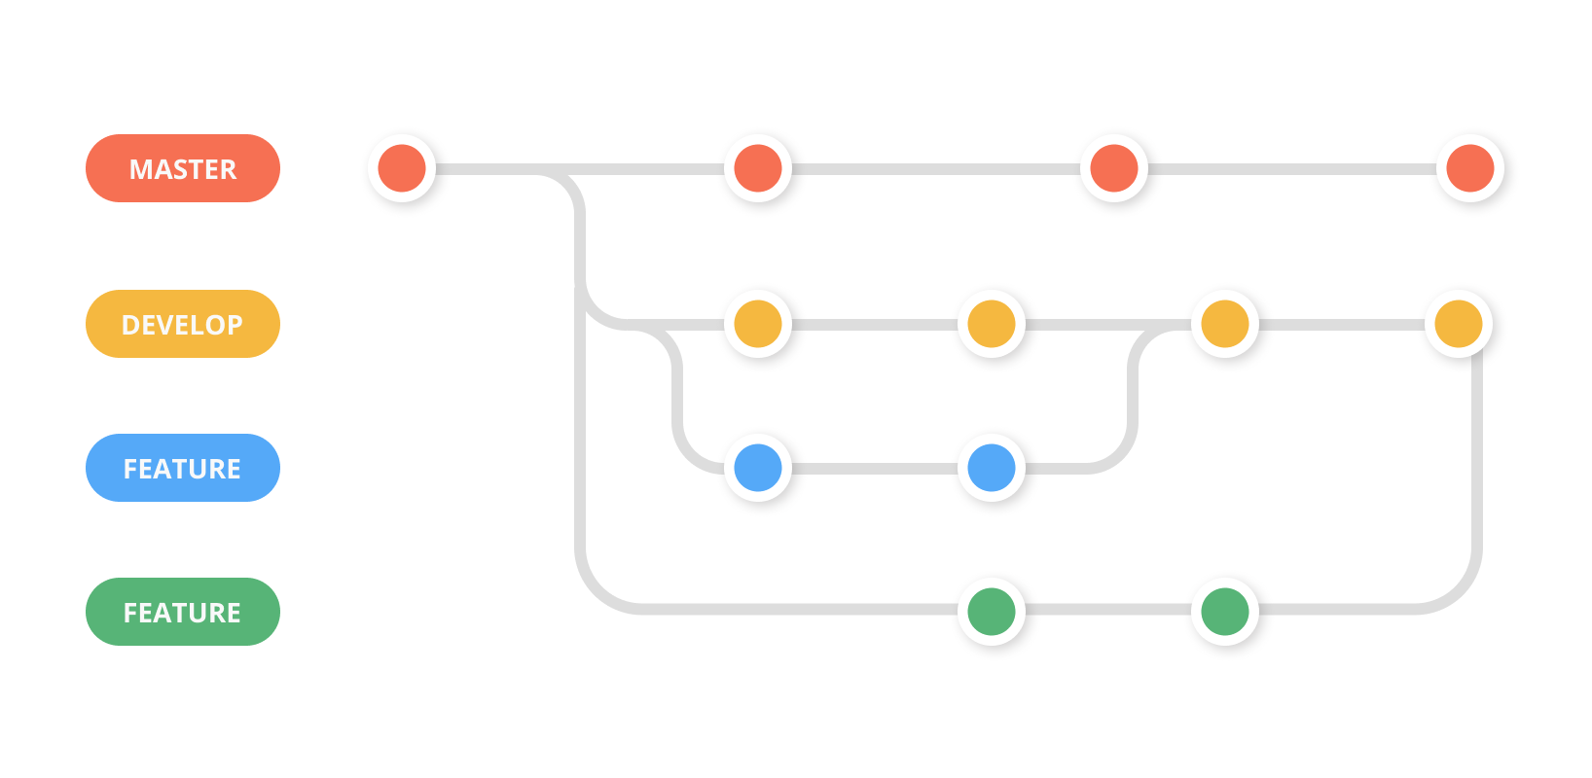
Create a new Branch
git branch # List existing branch
git branch [newBranch] # Create branch
git checkout [newBranch] # Checkout into branch

Slide 11
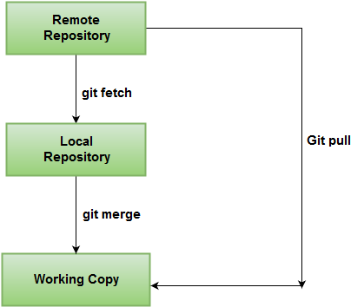
Collaborate with Others
git fetch
Download objects and refs from another repository
git pull
Fetch from and integrate with another repository or a local branch
merge [default]
rebase
git push
Update remote refs along with associated objects

Slide 12
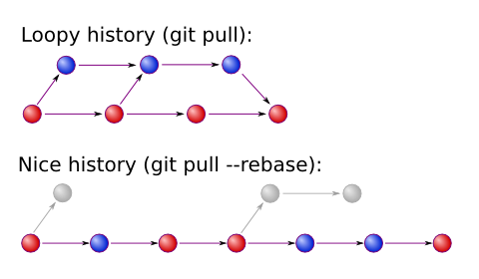
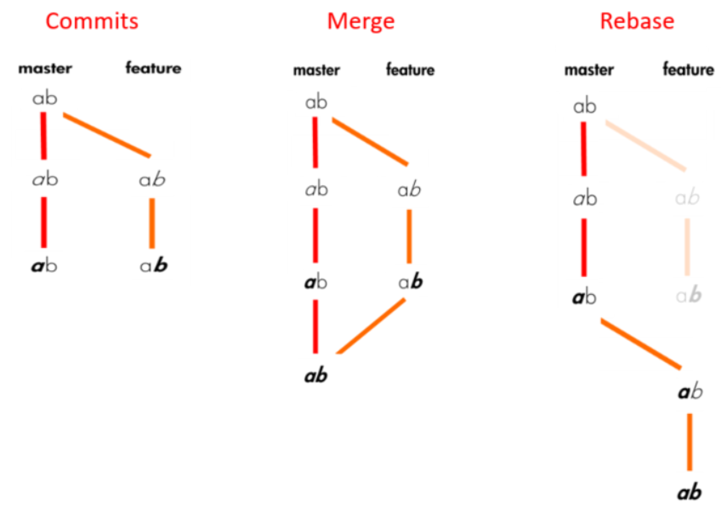
Merge vs Rebase

Slide 13
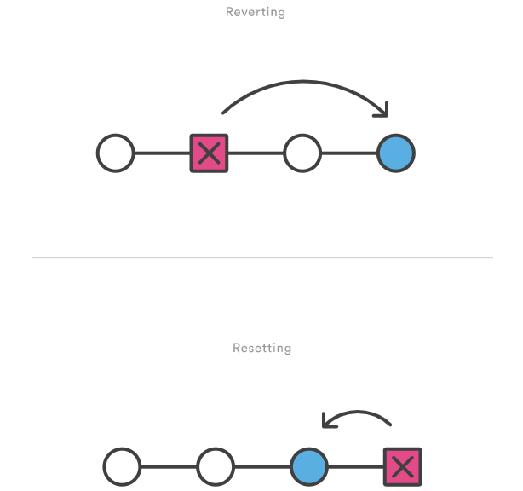
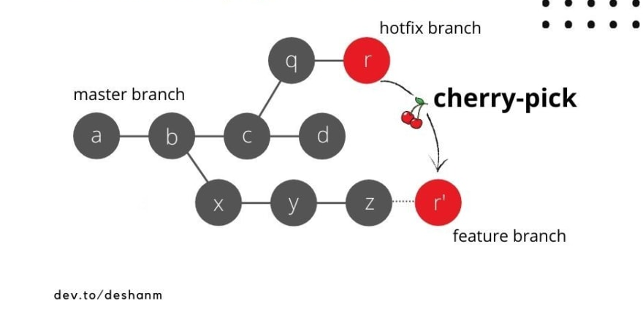
Other useful commands
git cherry-pick git revert
git tag

Slide 14
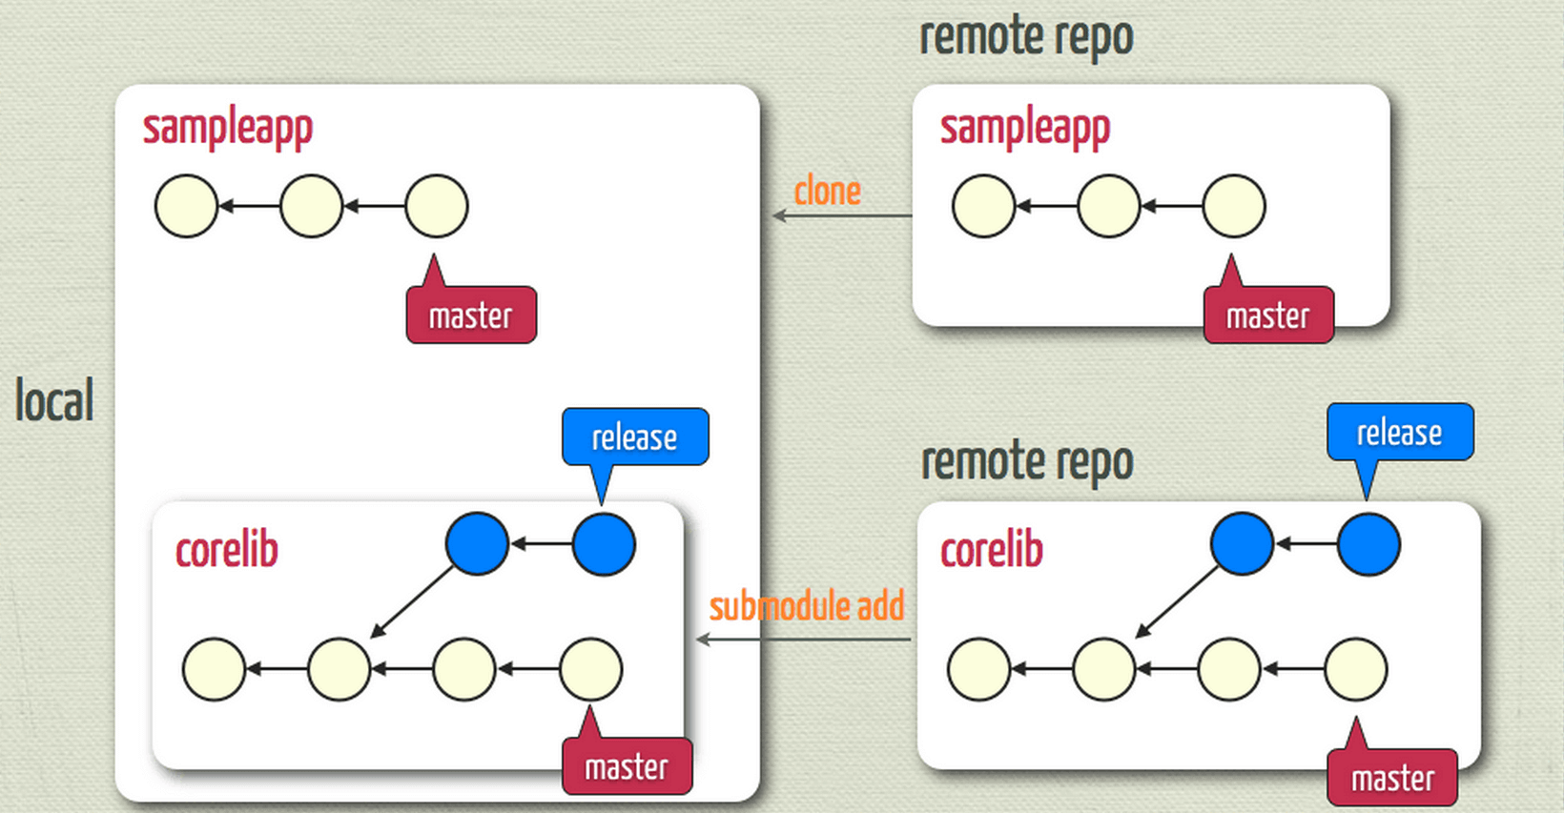
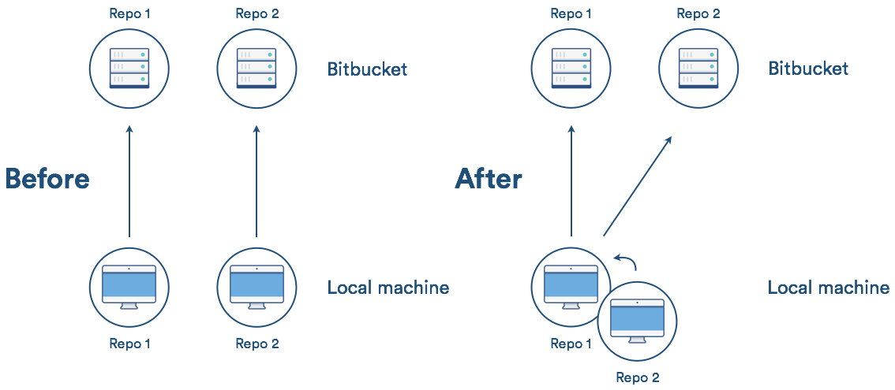
Submodule vs Subtree
Submodule
Subtree

Slide 15
Submodule vs Subtree Summary
 | Submodule | Subtree
Cost | Contain reference in .gitmodule only | Contain whole SubRepo project
Clone SuperRepo | Extra steps needed git submodule init git submodule update | Simply clone as usual
Push SubRepo | Easy, since both of them are independent Repo | Hard, identify the related files and compare with old version is needed
Pull SubRepo | Hard, similar with Clone | Easy, similar with Clone
Simple description | SuperRepo shadow linking with SubRepo | SuperRepo adopt SubRepo and treat as a Single Repo after that
Ref: https://blog.puckwang.com/post/2020/git-submodule-vs-subtree/

Slide 16
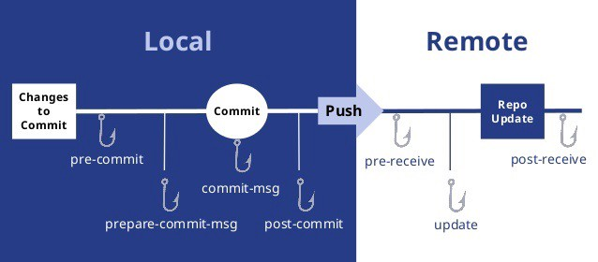
Git Hook
A way to fire off custom scripts when certain important actions occur.

Slide 17





Git Hosts

